Slide 1
Multi-sited research
Carol Worthman, Emory University
Eileen Anderson-Fye, Case Western Reserve
Tanya Luhrmann, Stanford University
Notes:
Ethnography in/of the World System: The Emergence of Multi-Sited. Ethnography. George E. Marcus

Slide 2
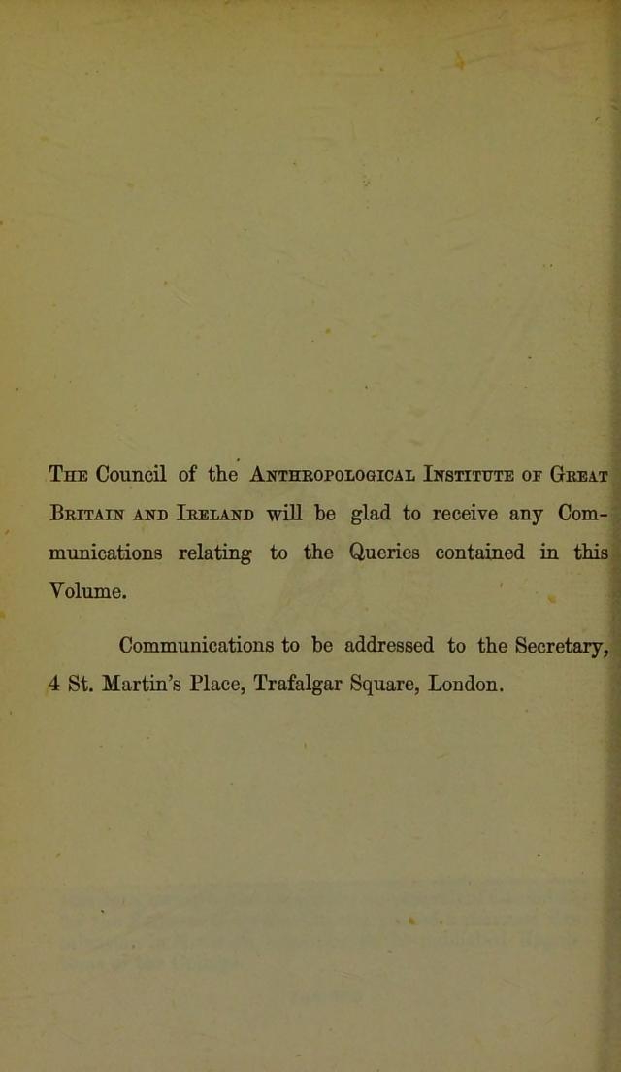
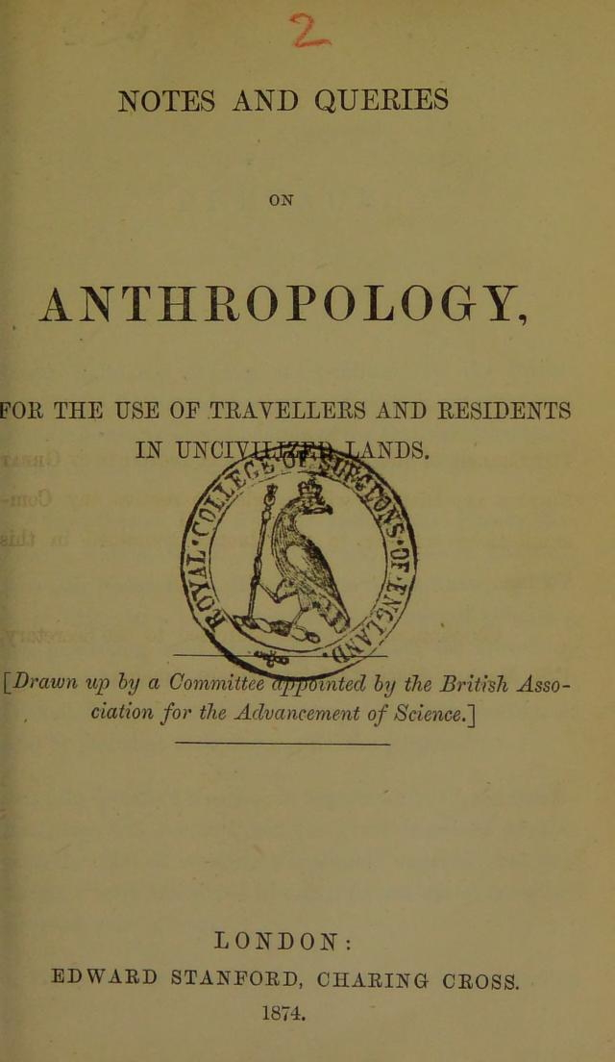
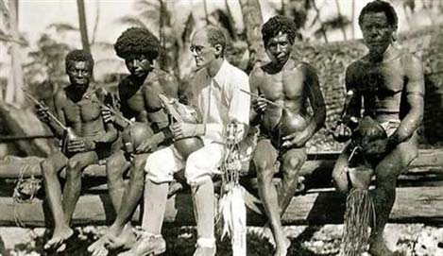
Notes and queries: the colonial enterprise
1892
1874
Notes:
Manual for Colonists

Slide 3
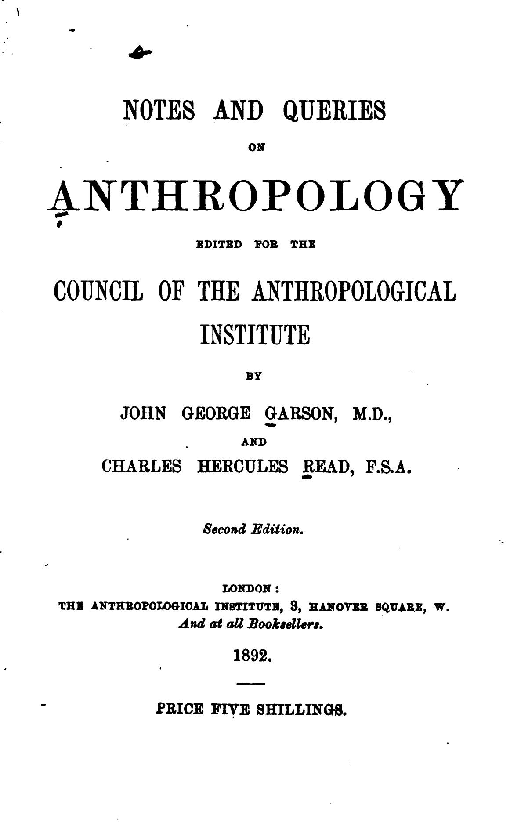
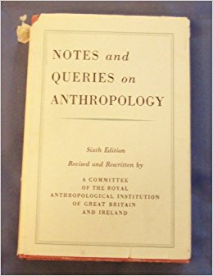
Notes and queries: professionalization
1892
1951

Slide 4
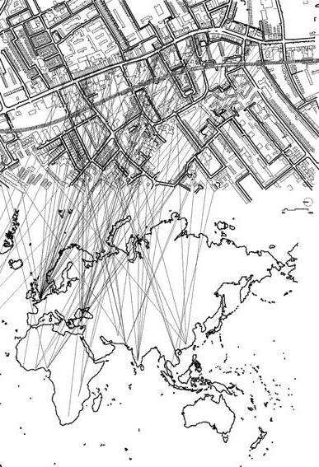
Goals
What are yours

Slide 5
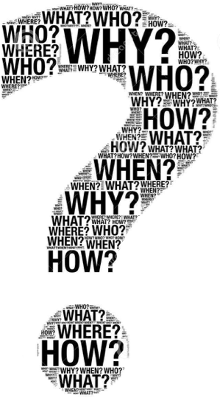
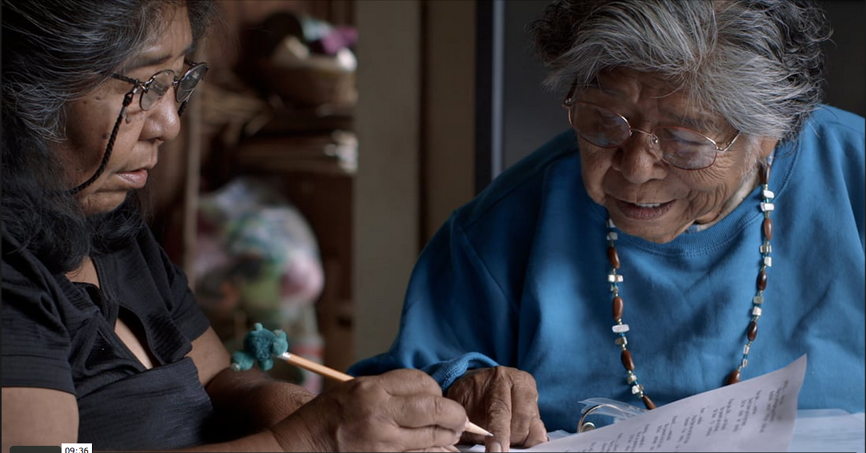
Multi-sited research
Why?
Who?
Where?
How?

Slide 6
Six Cultures Study of Socialization: Why?
1954-7
Test a theory of culture and personality
Environment
History
CONTEXT
Place
Time
Maintenance
Systems
Projective-
Expressive
Systems
POPULATION
Child’s Learning
Environment
Individual Adult
PROXIMAL
Learned
Innate

Slide 7
Six Cultures Study of Socialization: Who?
PIs:
Anthropology: JWM Whiting
Social psychology: IL Child, WW Lambert
Discussion groups
Anthropologists, psychologists
Field Manual for the Cross-Cultural Study of Child Rearing
Field teams: Anthropologists familiar with the culture
Discussion groups: experts, PIs, Beatrice Whiting, experts, field teams
Field Guide for a Study of Socialization

Slide 8
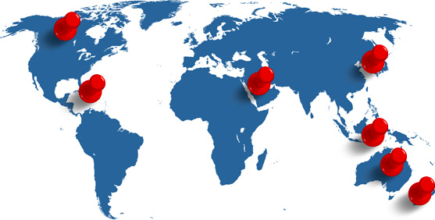
Six Cultures Study of Socialization: Where?
Where? Mexico, India, Kenya, Okinawa, the Philippines and the United States
Unit of analysis: primary social unit (local community where fieldwork was conducted)
One year fieldwork (too short)

Slide 9
Six Cultures Study of Socialization: How?
Process, protocols, procedures
Collaboration, iterative discussions
Field manuals
Participant observation/ethnography
Tension: hypothesis testing vs. discovery
Problems of slow communication, data transport and analysis
Systematic comparable data vs. local specifics
Standardized interviews retrospective, problematic
Turned to undisputed data sources: behavioral observation and ethnography
Notes:
Problem of retrospective reports

Slide 10
Comparative Adolescence Project – 1982-5
Why? Similar to Six Cultures Study
Effects of social change (schooling)
Who?
PIs: social anthropologists: Robert LeVine, Beatrice Whiting; child psychologist: Jerome Kagan
Postdocs
Where? Australia, Canada, Kenya, Nigeria, Romania, Thailand
How?
Team discussions
Structured inventories and tasks, behavior observation, ethnography
Notes:
My Kenya study was based on the Child Development Research Study sample in Ngecha

Slide 11
Multi-sited research: early lessons
Why?
Theory testing vs. tapping diversity
Clarify (latent) constructs and models
Who?
Diversity vs. comparability of teams
Multiple disciplines (context, persons, embodiment)
Where?
Choose sites strategically
How?
Balance discovery and comparability
Advance planning for data streams and analysis
New technologies; longitudinal designs
Notes:
https://www.google.com/search?hl=EN&site=imghp&tbm=isch&source=hp&biw=1067&bih=595&q=world+systems+theory+map&oq=world+system&gs_l=img.1.3.0l10.71.8539.0.11923.29.20.5.4.4.0.191.2428.0j16.16.0....0...1ac.1.64.img..4.24.2313...0i10i24k1j0i10k1.w93zc8niOmE#hl=EN&tbm=isch&q=lessons+learned&*&imgdii=gHa0K5HfzKRoJM:&imgrc=ydUbwvUDkr60qM:

Slide 12
Can we attend fully, with our whole beings, not just our minds?

